Slide 1
Hivelet
A Web-Based Apartment Management System for Fe Galang Da Silva Boarding House
IT 124 Capstone Project 2 · Group 4, BS Information Technology · Bicol University College of Science
[Team members] · Adviser: [name] · [Defense date]
Notes:
Introduce the team and the client: a 33-unit boarding house in Legazpi City, 32 of them occupied, run by its owner.

Slide 2
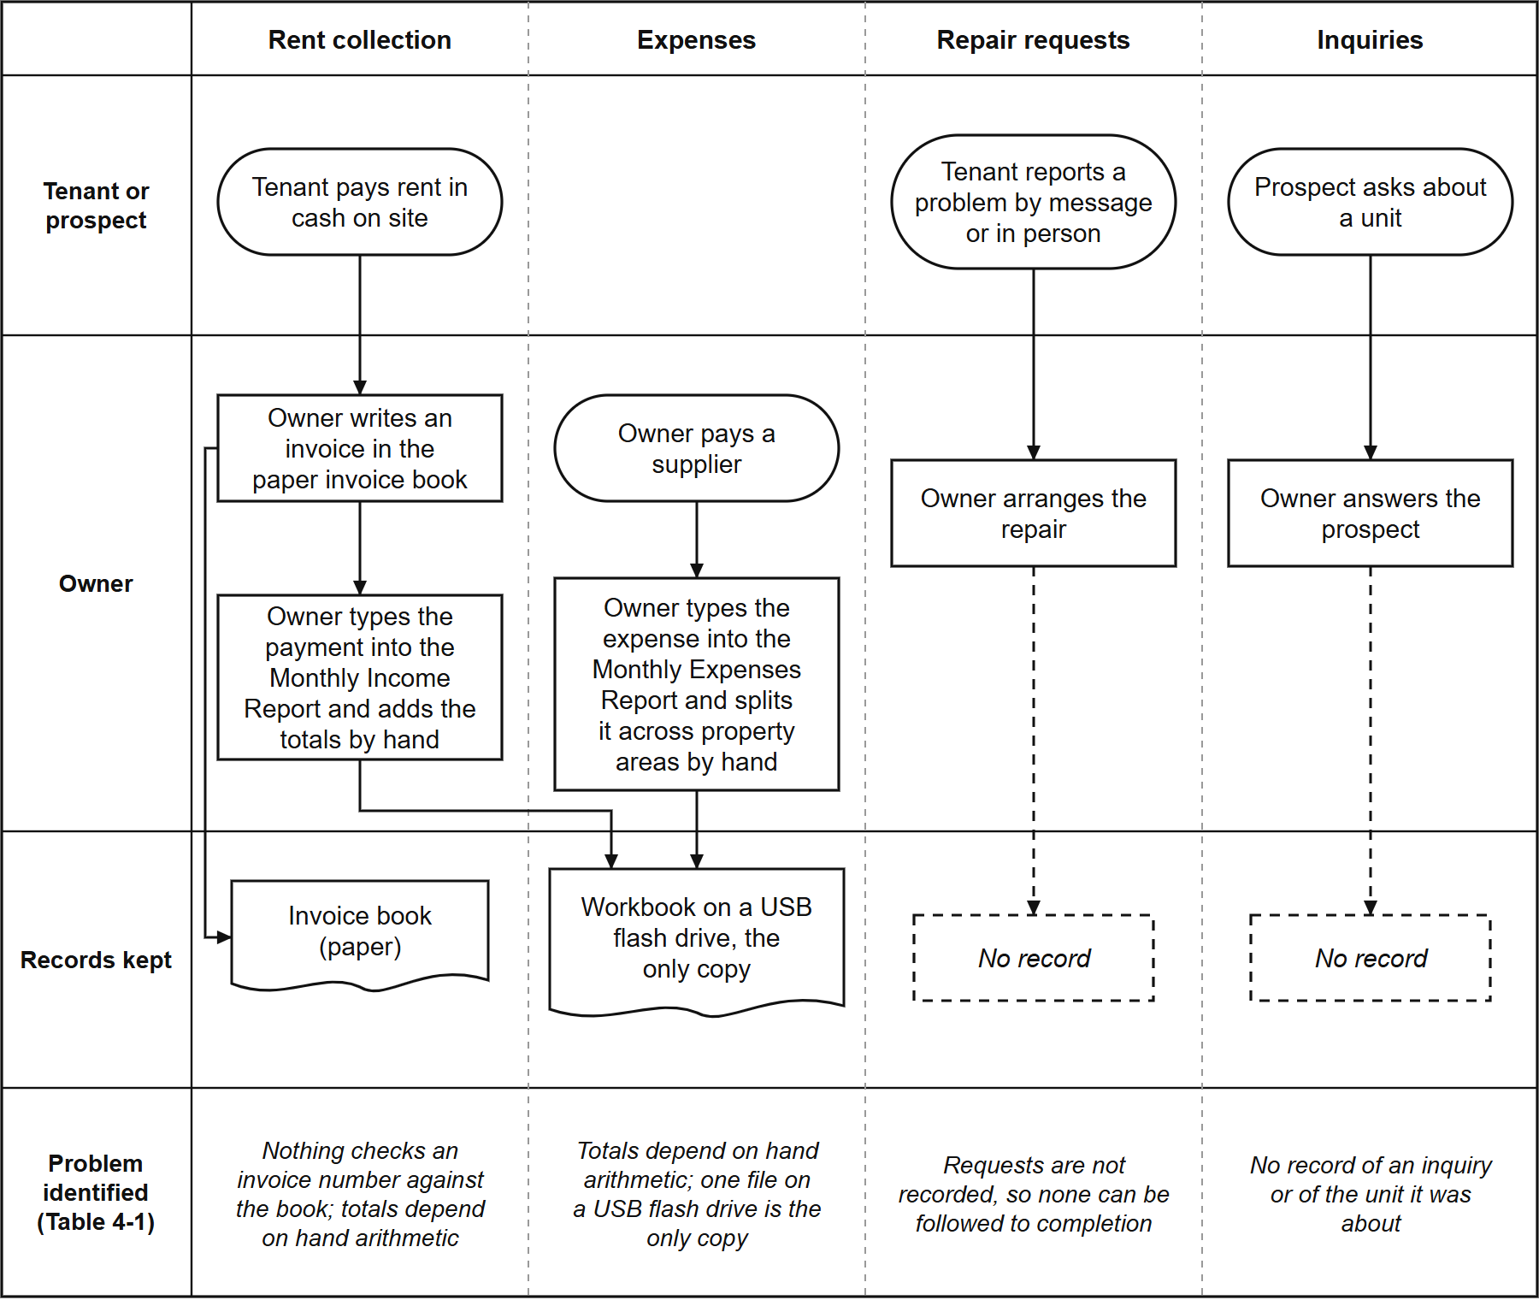
Before Hivelet: four areas, four separate records
Income and expenses typed into a workbook on a USB flash drive, the only copy
Invoices written in a paper book; rent collected in cash on site
Repair requests by message or in person, never recorded
Inquiries through Facebook, referrals, texts and walk-ins, with no record of which unit
Notes:
Walk the four columns of the figure left to right. The point: every path ends in a record kept apart from the others, or in no record at all (Chapter 4, Section 4.1.1).

Slide 3
What the owner's own records showed
937
1,327
43%
5
income rows transferred
expense allocations transferred
402 of the 937 rows had no anniversary date and no deposit
invoice numbers each used for two payments
The problem was not the lack of a digital tool. It was that nothing connected one record to another.
Notes:
These come from transferring her real workbook into the system (Section 4.1.1). The records were kept exactly as she wrote them; the system reports the anomalies rather than correcting them.

Slide 4
Objectives of the study
To design, develop and evaluate Hivelet, a web-based apartment management system that integrates the boarding house's administrative workflow, communication and operational control.
Analyze the existing practices and set the system requirements
Develop tenant and room management, booking, financial tracking with optional online payment, maintenance ticketing and notifications, role-based access control, and PWA support
Pilot test the system for functionality, responsiveness and operational performance
Evaluate and optimize it with the ISO/IEC 25010 software quality model
Notes:
Read the general objective, then the four specific ones. The conclusions near the end answer each one in the same order.

Slide 5
What related studies did, and what was missing
Magno et al., 2024
Pernate et al., 2025
Mangca, 2023
Apartment rental records and tasks (Negros)
Finding and booking boarding house rooms (Ormoc City), ISO/IEC 25010
Boarding house booking with SMS notifications (Surigao City)
Puspasari et al., 2025
Canlas et al., 2026
The gap: one system that integrates records, money, requests and inquiries for a small, cash-based boarding house
Billing notifications, but only the manager uses it
Dormitory maintenance reporting, Agile, ISO/IEC 25010
Notes:
Each study solves one part. Canlas et al. (2026) is the closest in method and respondents; Puspasari et al. (2025) is the clearest example of the gap: only the manager can use it.

Slide 6
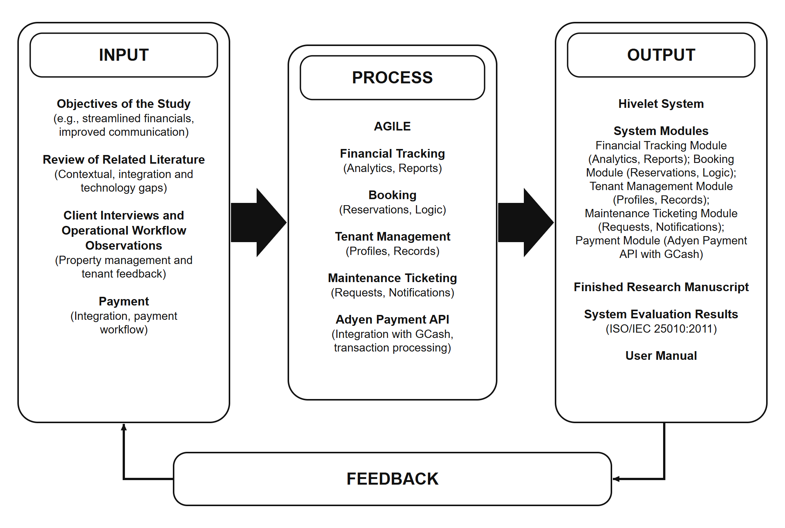
Conceptual framework
Notes:
Input, process, output, with feedback into the next iteration (Chapter 2, Section 2.3).

Slide 7
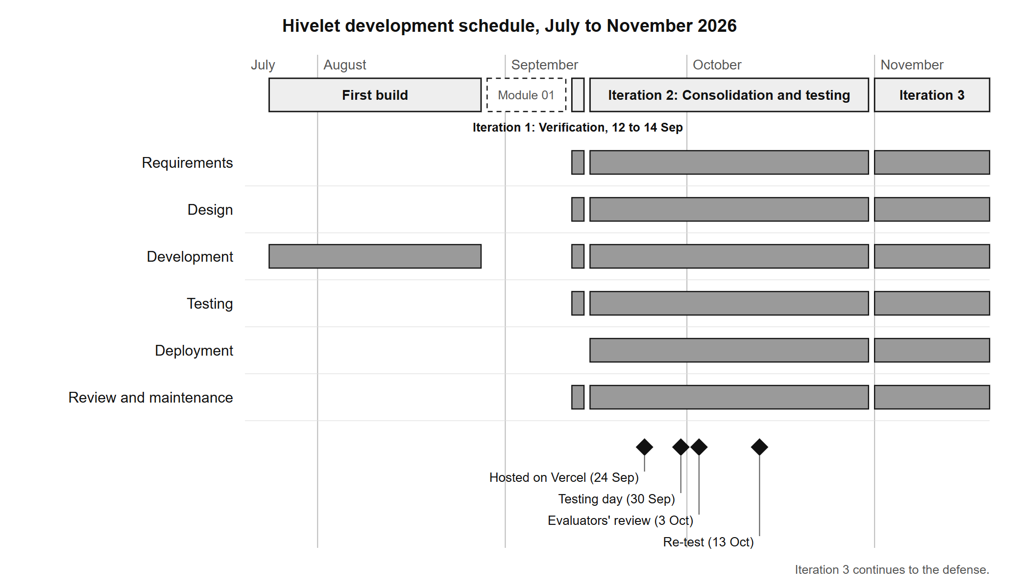
Method: Agile, in three iterations
First build, 24 July to 28 August
Iteration 1, 12 to 14 September: 22 recorded errors corrected
Iteration 2, 15 September to 31 October: testing and evaluation
Iteration 3, from 1 November: interface redesign
Each iteration ran the phases it needed: requirements, design, development, testing, deployment and review. Iteration 1 had no deployment work.
Notes:
Iteration 1 is the honest part of the story: it checked the system and its documents against each other and corrected 22 recorded errors, many written in the first build with the AI assistant and never checked.

Slide 8
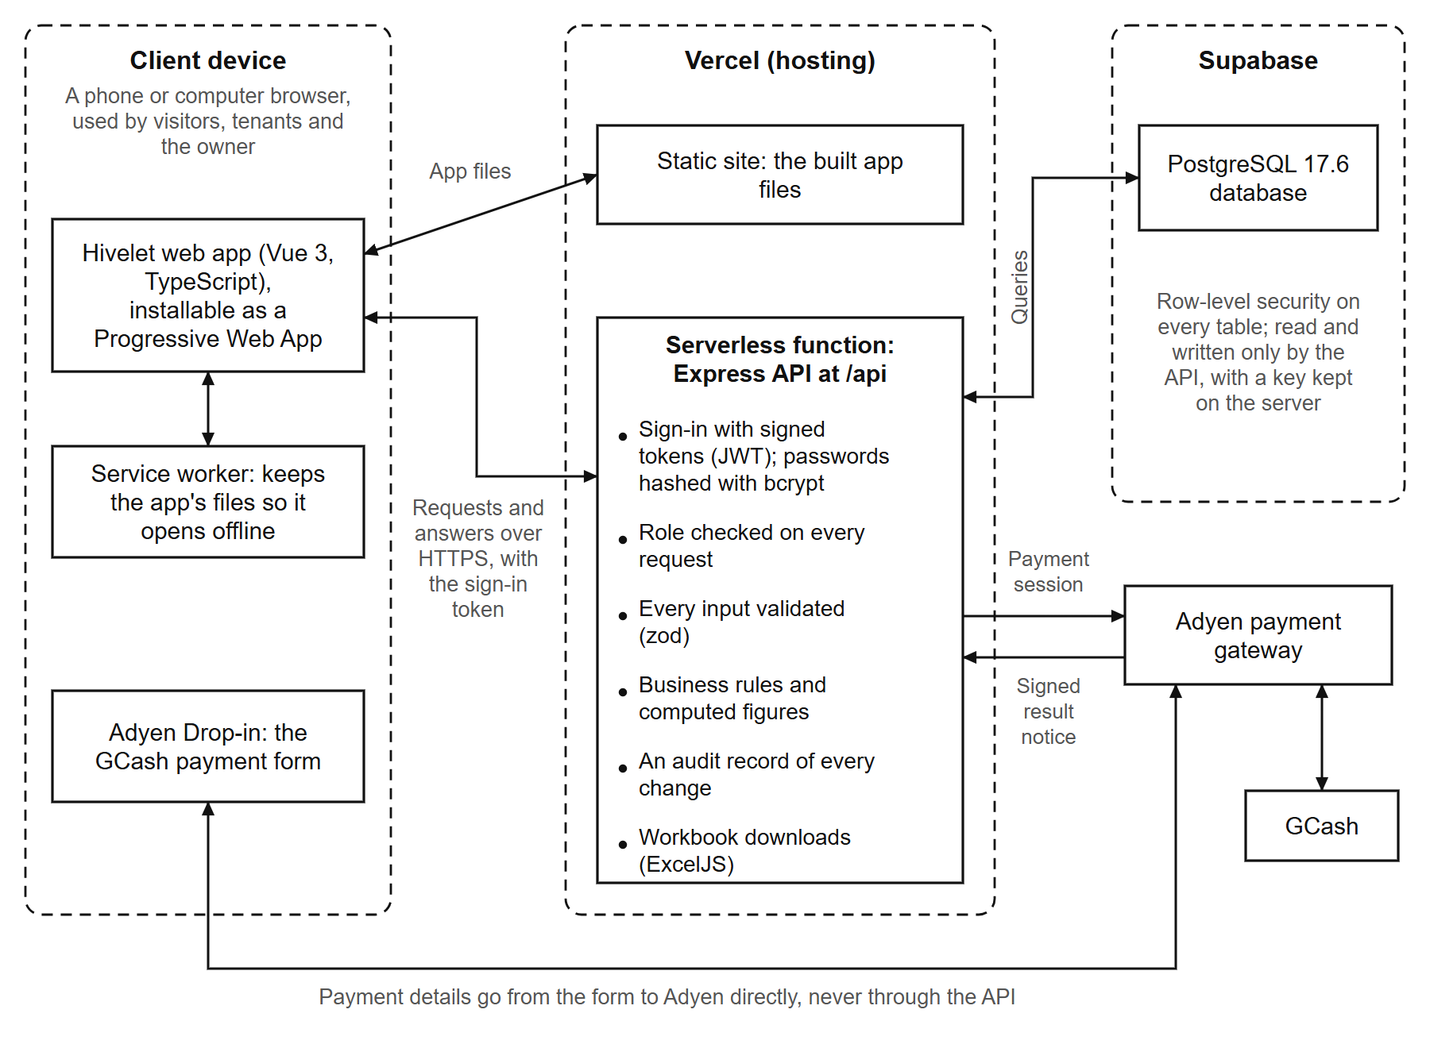
How it is built
Vue 3 and TypeScript, a Progressive Web App
Express API in TypeScript
PostgreSQL on Supabase, row-level security on every table
Adyen with GCash for the optional online payment
Hosted on Vercel
Notes:
Express is the security boundary: the browser never talks to the database directly. Row-level security is on all 24 tables.

Slide 9
Six features, one system
Tenants and rooms
Booking and inquiries
Financial tracking
Move-in, move-out, occupants, deposit; every rate change recorded
Public catalogue; an inquiry about a unit, answered in a thread
The owner's own ledger layout, invoice numbers and Excel workbooks
Optional GCash payment
Repairs and notifications
Roles and the PWA
Through Adyen; counts only after the owner verifies it
A request with photos, followed to completion
Each person sees only their part; installs from the browser, reads offline
Notes:
These are the six the second objective names (Chapter 4, Sections 4.2.2 to 4.2.7).

Slide 10
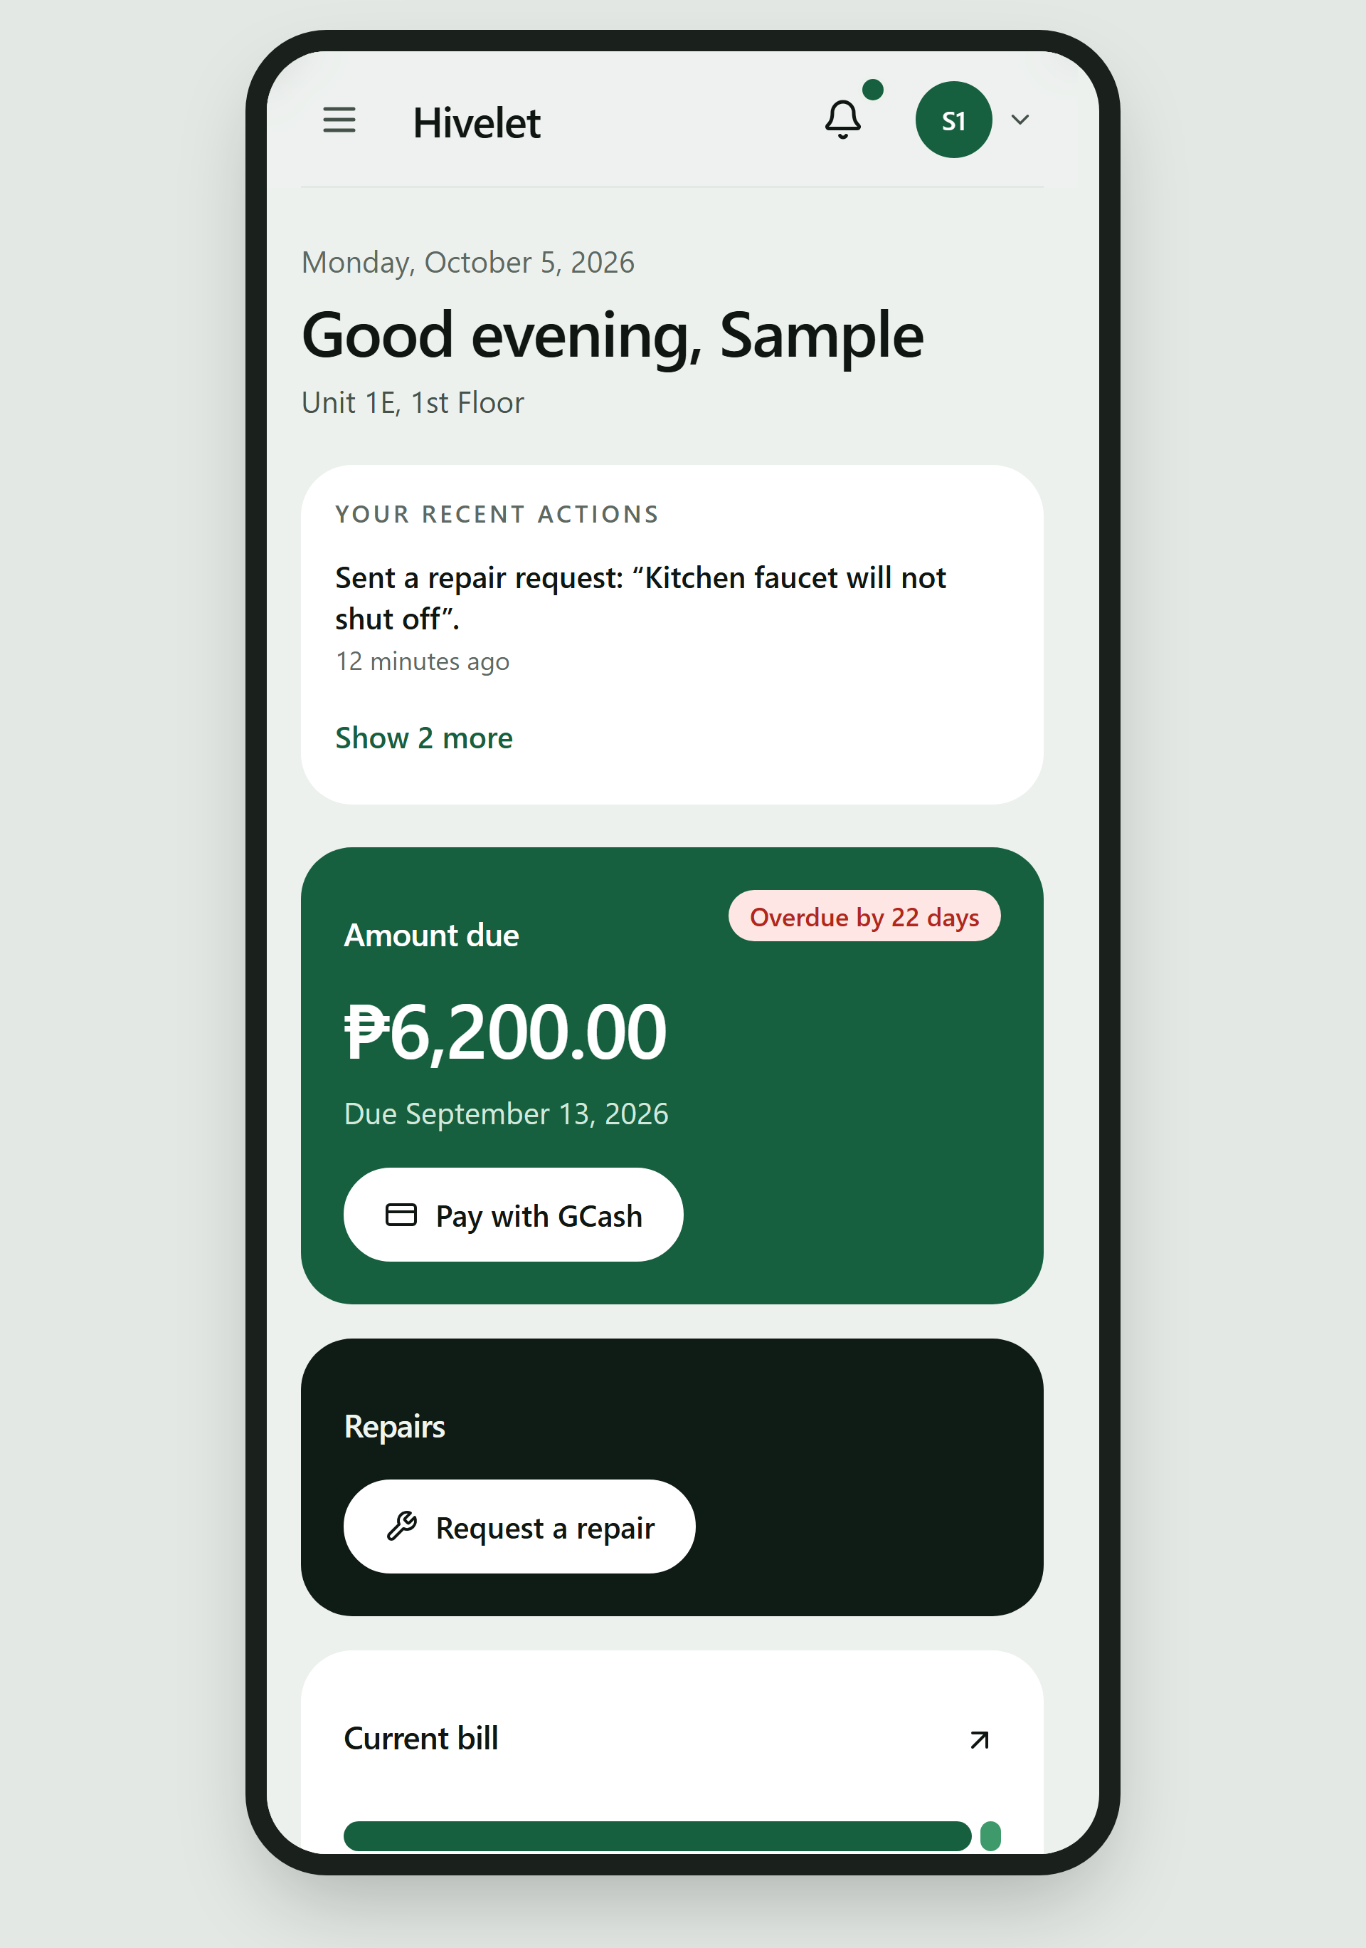
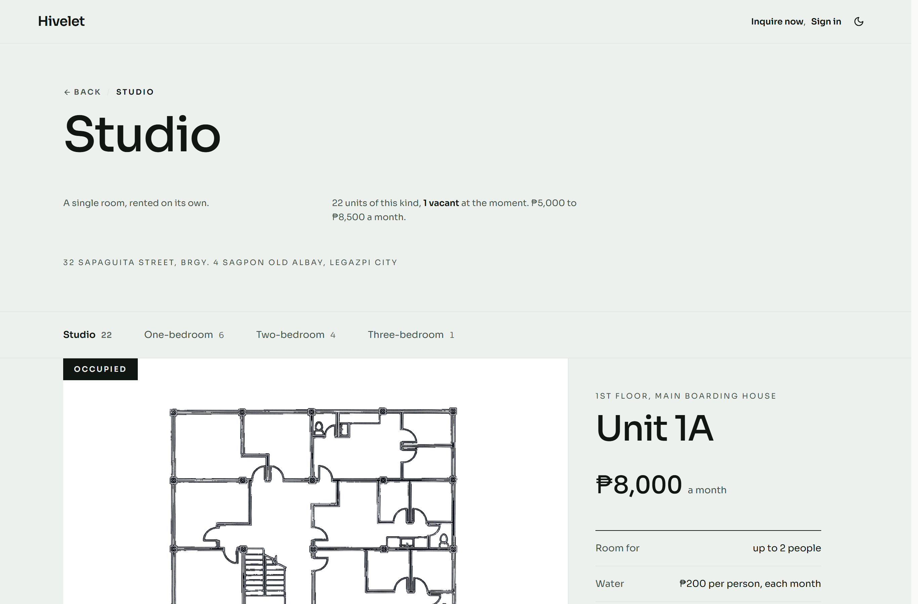
What a visitor and a tenant see
Notes:
Left: the public unit catalogue (Figure 4-8). Right: the tenant portal on a phone (Figure 4-11). Sample records; the units and rates are real.

Slide 11
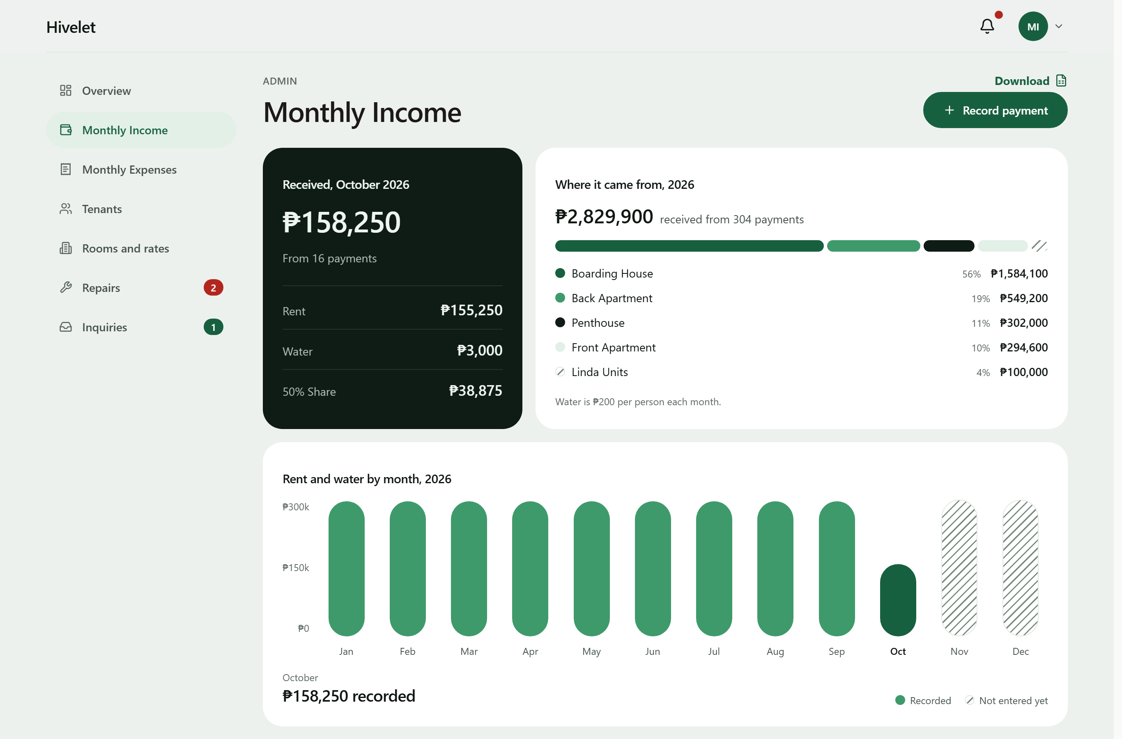
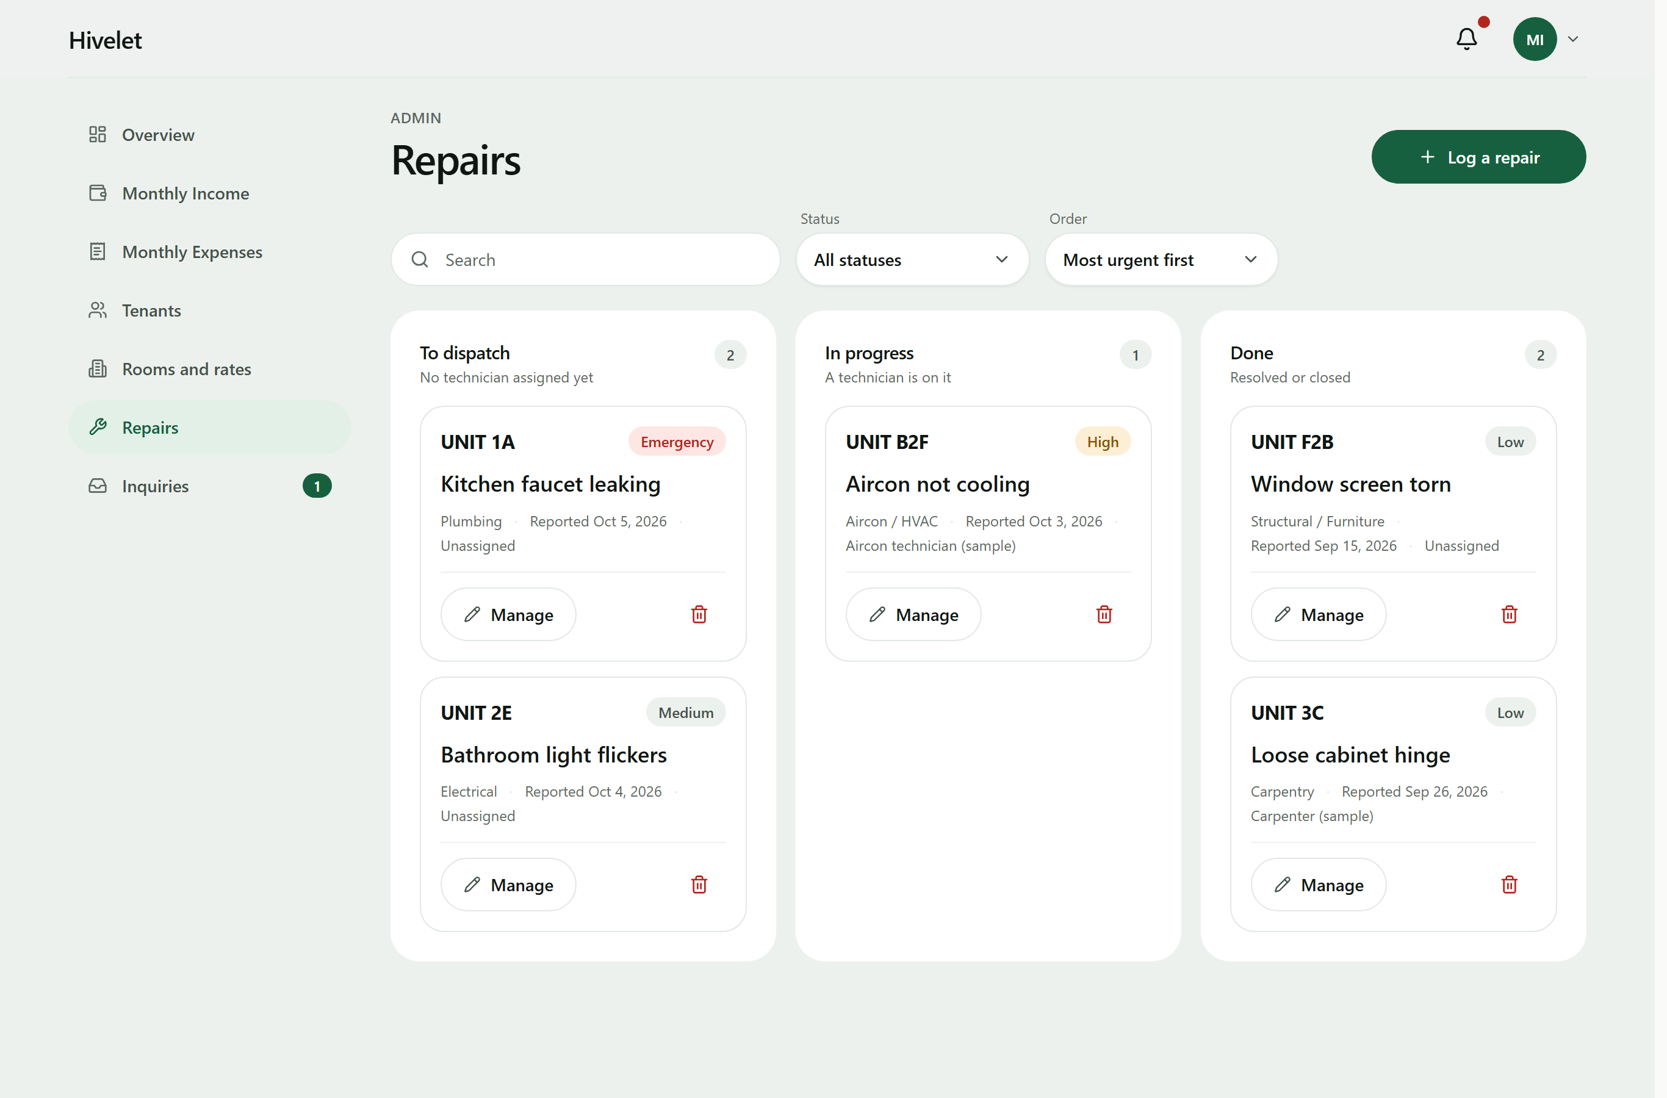
What the owner sees
Notes:
Left: the monthly income ledger in her workbook's layout (Figure 4-9). Right: the repair board (Figure 4-10). Sample records.

Slide 12
Security
Passwords stored only as bcrypt hashes, each with its own salt
Too many wrong passwords lock the account for 15 minutes; breached passwords are refused
One permission matrix; a tenant sees only their own records
Row-level security on all 24 database tables
Every owner action in an audit trail the application cannot erase
Every gateway message checked by its HMAC signature before anything is written
Notes:
Two weaknesses are named in the paper and recommended for later: the sign-in token is kept in the browser's storage, and the administrator has no second sign-in factor (Section 4.4.4).

Slide 13
Pilot testing: 82 of 83 tests passed (98.8%)
Level | Activity | Executed | Passed
Unit and integration | Automated check suites | 20 | 20
System | Owner's functional walkthrough | 25 | 24
Acceptance | Tenant tasks | 34 | 34
Acceptance | Simultaneous use | 4 | 4
All levels |  | 83 | 82 (98.8%)
No critical defect. 35 defects found across all activities: 32 resolved, 3 accepted as low risk.
Notes:
Four layers, on the ISO/IEC/IEEE 29119 levels (Table 4-12). The one failure, a ₱0 shown with the connection cut, passed when re-tested on the owner's laptop on 13 October. The course standard is 90 percent.

Slide 14
Fast, and safe when the connection is not
3.05 s
0 of 1,085
10 of 10
1 saved
slowest screen on a phone (the tenant portal's first load)
requests failed with 12 simulated users at once
addresses opened with no connection
when the same receipt was sent five times at once
A page stops waiting after 25 seconds and says so; a save after 45 seconds says it cannot tell whether it arrived
A figure that cannot load is shown as unavailable, never as ₱0
A change on one device appears on another within about 2 seconds
Notes:
Load times are from 30 September on real devices (Table 4-10). The load test used simulated users, not people. Saves arriving at the same instant are refused by the database itself.

Slide 15
The owner and three tenants used it themselves
34 of 34
31
60 s
24 of 25
tenant tasks completed
of them without help (91%)
median time per task
walkthrough steps the owner performed passed the first time
Where tenants needed help: the first sign-in and finding their unit and rent. Chapter 5 recommends showing each new tenant those first.
Notes:
Observed on their own devices with a fixed help ladder; testers thought aloud (Chapter 3, Section 3.3; Chapter 4, Section 4.3.7).

Slide 16
ISO/IEC 25010 evaluation: 4.59, Very High Quality
Notes:
Composite means (Table 4-17), mean of the group means. Ten respondents: the owner, three tenants, a prospective tenant and five technical evaluators. Every characteristic Very High Quality.

Slide 17
Measured and rated evidence agree on all eight
27 of the 31 sub-characteristics measured by tests; 25 rated by the survey
Usability (4.42): nine tasks in ten done without help; the owner rated learning without help lower
Maintainability (4.32): checks pass on every change, but three database calls in four sit inside the request handlers
The 14 comments of 3 October were all acted on by 5 October
51 optimizations in all, each traced to the finding that caused it (Appendix M)
Notes:
Usability agrees once the later technical evaluators had rated it. The owner's two 3s still mark where a first-time user needs help (Section 4.4.5).

Slide 18
Conclusions: all four objectives achieved
1. Analyze the practices
2. Develop the system
Every gap in the owner's practices traced to a requirement and a module
All six features built and in use on her real records, in her own layout
3. Pilot test it
4. Evaluate and optimize
82 of 83 tests passed (98.8%), with no critical defect
Very High Quality overall (4.59) on ISO/IEC 25010; 51 optimizations made
Notes:
One line per objective, in order (Chapter 5, Section 5.2).

Slide 19
Recommendations
The owner
The system
Future researchers
Keep the system's receipts up to date with her receipt book.
Keep a backup before any change to the records.
Move Adyen from test to live, with refunds.
A protected sign-in cookie and a second sign-in factor.
Automated browser tests for the 26 walkthrough steps, and faster first loads on phones.
Raise Maintainability (service modules) and Usability (first-use guidance).
Check a system against its own real data, not only against test records.
Evaluate over a longer period, with every tenant.
Notes:
Grouped by who acts on them (Chapter 5, Section 5.3).

Slide 20
Thank you
Questions, and a live demonstration
hivelet.vercel.app
Notes:
Switch to the demo: FINAL/DEMO_SCRIPT.md. Test tenant on unit PH only; reject the GCash payment, never verify it.

